Slide 1
LA Metro Training
ClearGuide Roadways
February 13, 2025

Slide 2
Agenda
Dashboard Overview
ClearGuide Roadways - Use Case Review
Questions & Next Steps

Slide 3
Dashboard Overview

Slide 4
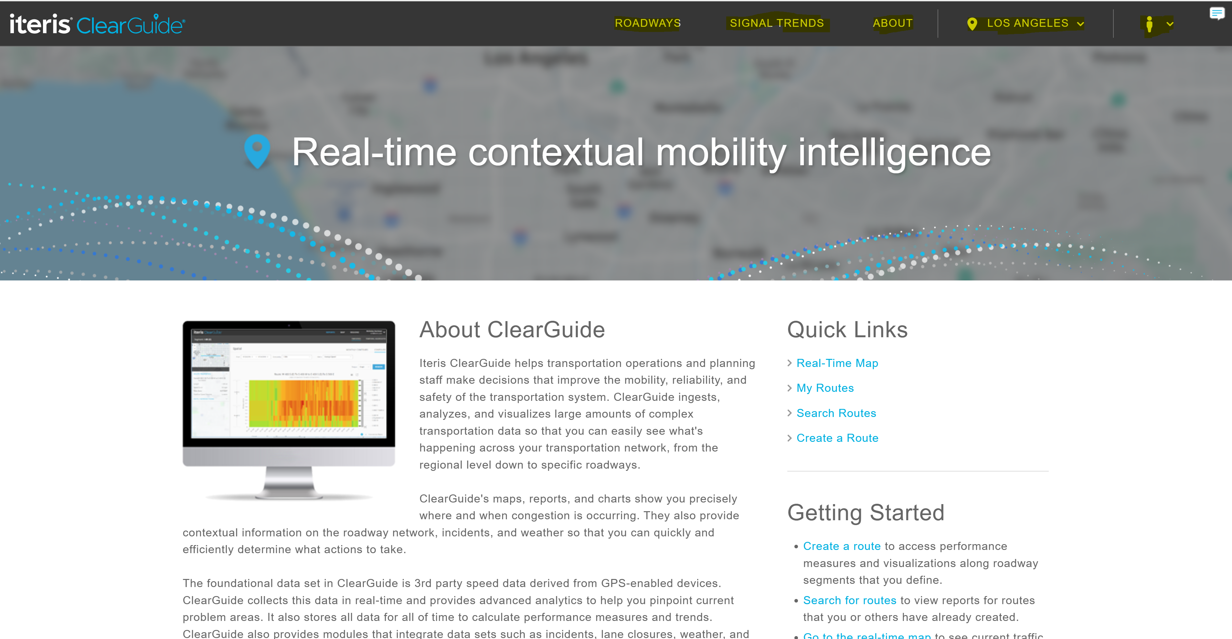
General Navigation of ClearGuide: metro.iteris-clearguide.com
Login
Roadways
Signal Trends
About
Default Location
Hyperlinks
Notes:
https://arashlaw.com/04-02-2024-one-person-killed-following-vehicle-vs-semi-truck-collision-in-glendale/

Slide 5
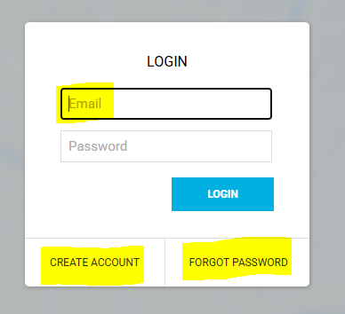
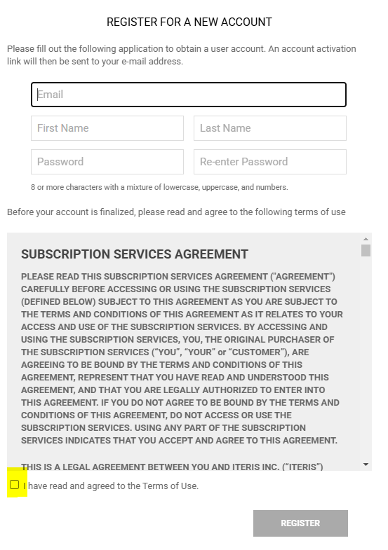
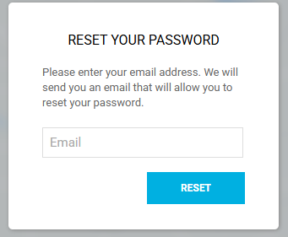
Login Steps
  Email address is the username
  Password is the password that you previously set
  If you have not created an account, select "Create Account" and fill out this form
  If you have forgotten your password, select "Forgot Password and fill out this form
Notes:
https://arashlaw.com/04-02-2024-one-person-killed-following-vehicle-vs-semi-truck-collision-in-glendale/

Slide 6
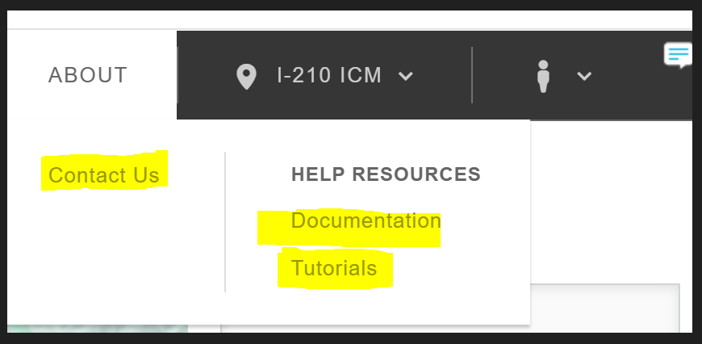
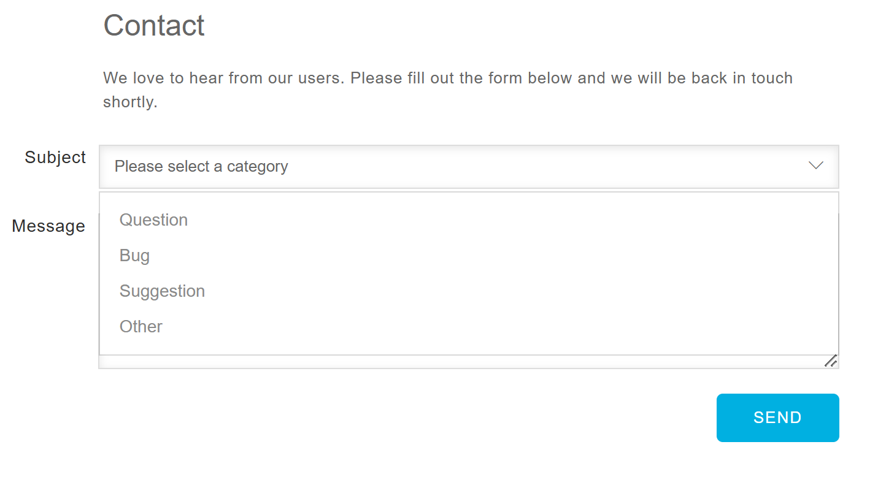
About Section
Contact Us
Help Resources
  Documentation
  Tutorials
Notes:
https://arashlaw.com/04-02-2024-one-person-killed-following-vehicle-vs-semi-truck-collision-in-glendale/

Slide 7
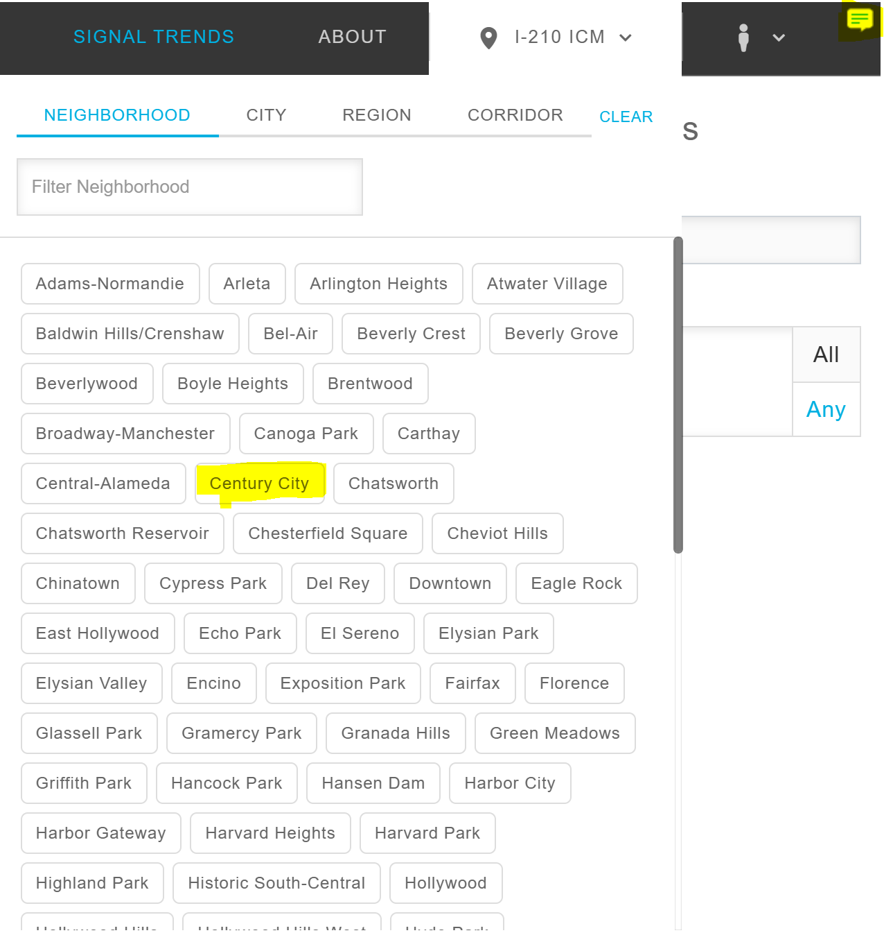
Geography & Feedback
Geography
  Able to Filter to
    Neighborhood
    City
    Region
    Corridor
Comment
  Able to add comment that is received by Iteris
Notes:
https://arashlaw.com/04-02-2024-one-person-killed-following-vehicle-vs-semi-truck-collision-in-glendale/

Slide 8





LA Metro Modules
Analyze and track congestion and export for reporting
Conduct congestion hotspot analyses and improve real-time operations
Improve work zone mobility through map tools and congestion alerts
Fix maintenance and operational issues before they become complaints
Maintain optimized signal timing
Leverage configurable alerts produced from the traffic signal controller
Notes:
ClearGuide: The most powerful transportation analytics solution available to assist in optimizing traffic flow, improving road safety & reducing congestion.
Improve safety and mobility
Turn large amounts of complex data into key insights
Make smart, data-driven operations and planning decisions
Reduce manual effort in congestion and safety plans

Slide 9
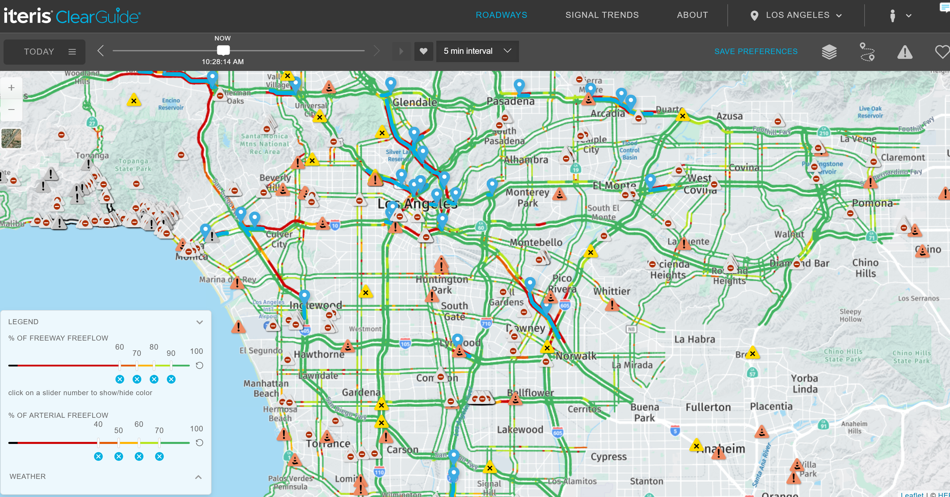
Roadways – Traffic Map
Calendar Feature
Map Layers
Routes
Incident Layer
Favorite
Legend
Notes:
https://arashlaw.com/04-02-2024-one-person-killed-following-vehicle-vs-semi-truck-collision-in-glendale/

Slide 10
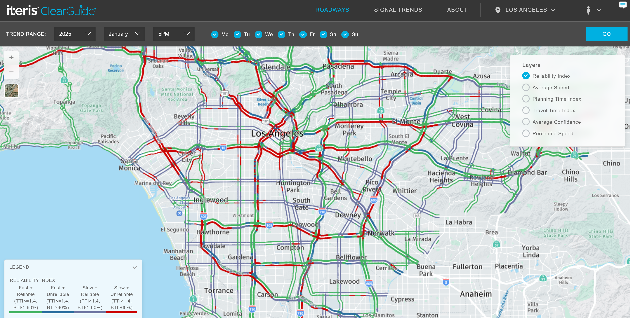
Roadways – Trend Map
Calendar Feature
Map Layers
Legend
Notes:
https://arashlaw.com/04-02-2024-one-person-killed-following-vehicle-vs-semi-truck-collision-in-glendale/

Slide 11
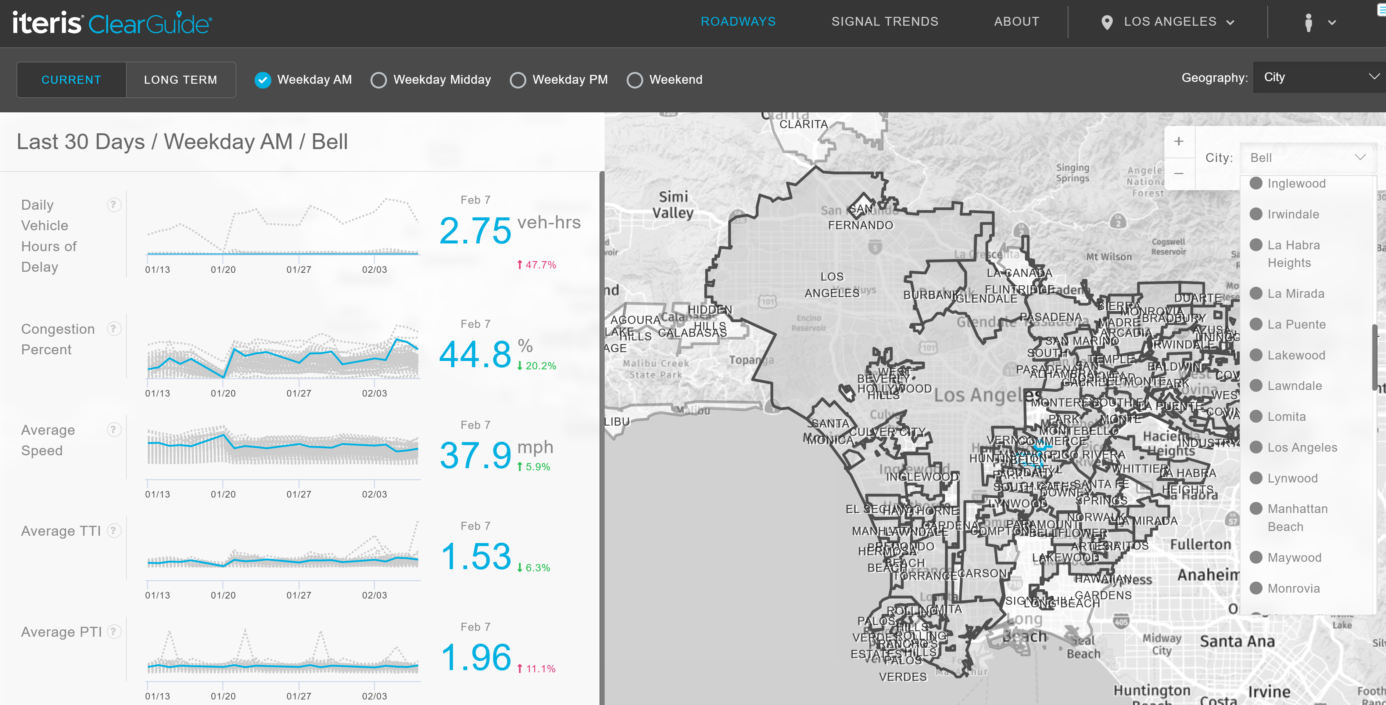
Roadways – Regional Dashboard
Calendar Feature
Map Layers
Legend
Notes:
https://arashlaw.com/04-02-2024-one-person-killed-following-vehicle-vs-semi-truck-collision-in-glendale/

Slide 12
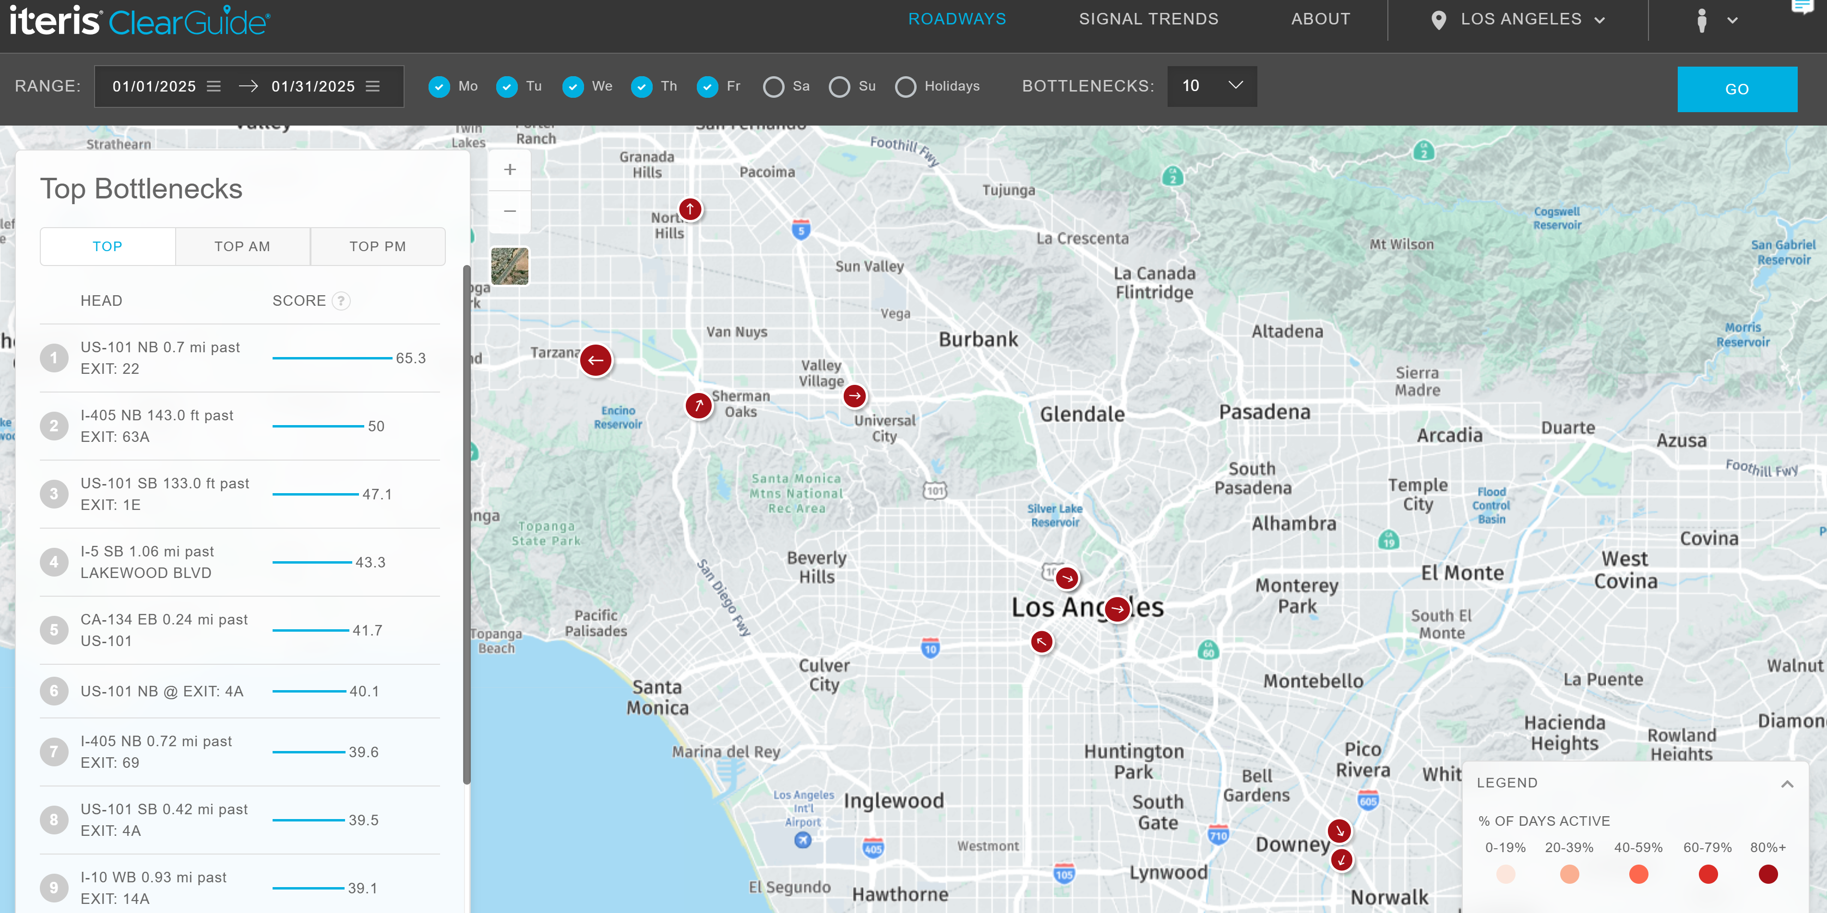
Roadways – Top Bottlenecks
Calendar Feature
Map Layers
Ranking of Top Bottlenecks
Legend
Notes:
https://arashlaw.com/04-02-2024-one-person-killed-following-vehicle-vs-semi-truck-collision-in-glendale/

Slide 13
Use Case Review

Slide 14
Use Case #1: Retiming of Signals on Prairie Ave. from W 118th St. to Redondo Beach Blvd.

Slide 15
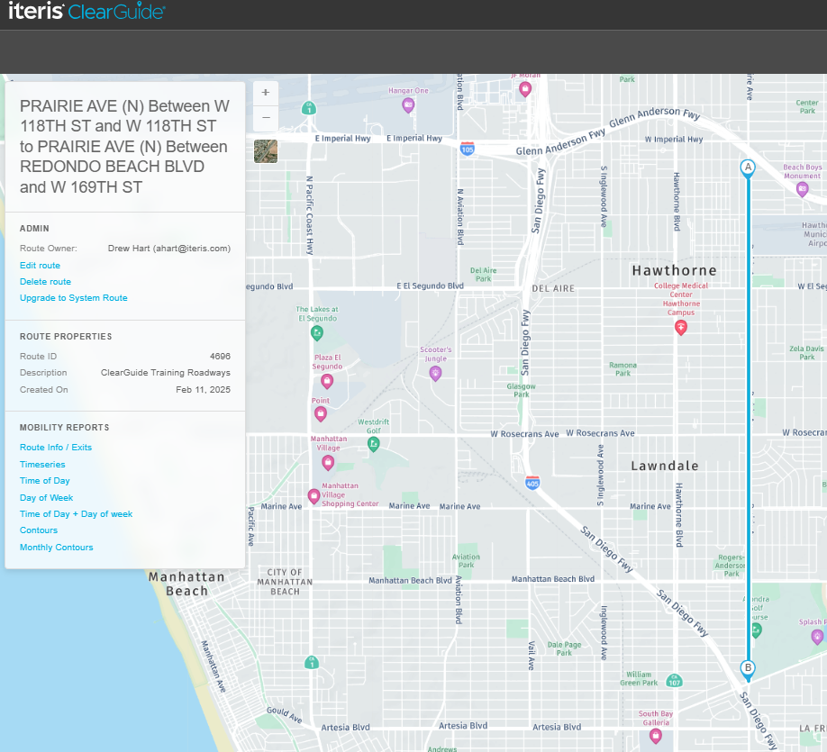
Prairie Ave. from W 118th St. to Redondo Beach Blvd.
Route Info. / Exits
Timeseries
Time of Day
Day of Week
Time of Day + Day of Week
Contours
Monthly Contours
Notes:
https://arashlaw.com/04-02-2024-one-person-killed-following-vehicle-vs-semi-truck-collision-in-glendale/

Slide 16
Use Case #2: 101 Freeway Incident

Slide 17
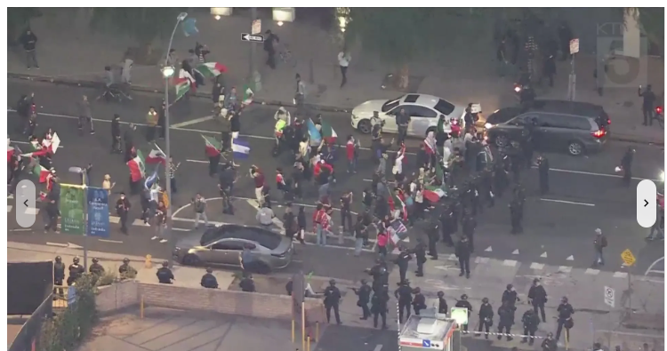
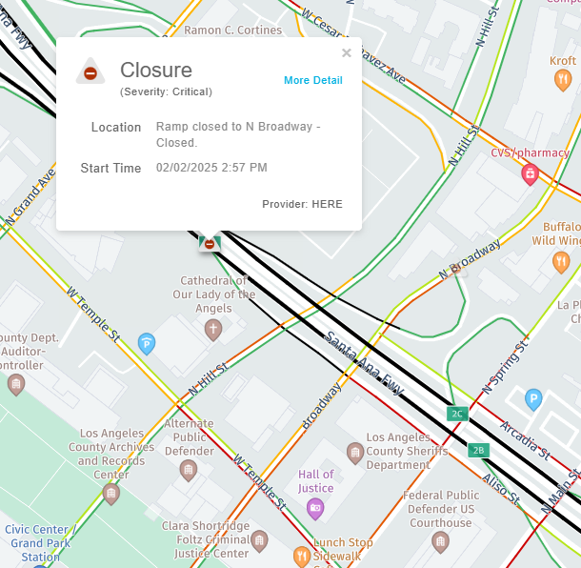
Protest on 101 Freeway: 2/2/25
Can use Roadways to:
  View impacts on map
  Visualize bottlenecks and congestion on contour map
  Perform timeseries and TOD analysis to compare impacts to normal conditions
Notes:
https://arashlaw.com/04-02-2024-one-person-killed-following-vehicle-vs-semi-truck-collision-in-glendale/

Slide 18
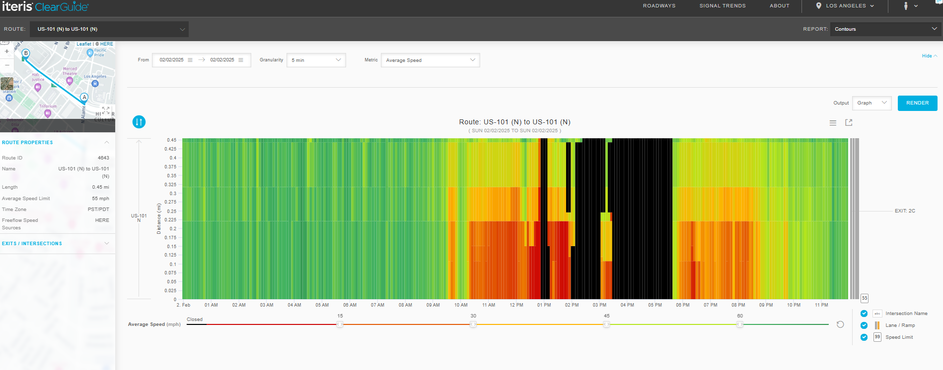
Protest on 101 Freeway: 2/2/25
Can
Notes:
https://arashlaw.com/04-02-2024-one-person-killed-following-vehicle-vs-semi-truck-collision-in-glendale/

Slide 19
Questions ?

Slide 20
Thank You!
Drew Hart: ahart@iteris.com
Scott Perley: sjp@iteris.com

