Slide 1

Locus training
April 21, 2026

Slide 2
Measure up! program
Measure Up! evaluates the performance of major arterials and provides origin-destination analysis throughout LA County, to provide agencies and stakeholders with a detailed, reliable assessment of service on each part of the network, and to establish a baseline for evaluation of various arterial improvements and investments.
The Measure Up! Program is comprised of several performance metric resources available for use:
  LOCUS
  Dashboards containing origin-destination trip visualizations for 2017, 2019 – 2025 (continuing into 2026)
  Migrated to new web-based platform (2021 data onwards)
  Clearguide
  An arterial and freeway performance measurement tool to better assess travel performance within Los Angeles County with map, route and data available in real-time and historically (2018 onwards)
  Workbooks & Reports
  Excel workbooks and PDF reports of travel performance for major arterials within the subregions
  Additional historical speed data available from Measure Up! from 2014 – 2018

Slide 3
POLL Question 1
What type of organization are you affiliated with?

Slide 4
POLL Question 2
Are you familiar with LOCUS?

Slide 5
agenda
MeasureUp! LOCUS
Product Roadmap
  Data Releases
  New Features
Existing and potential use cases of LOCUS
Platform demo
Q&A

Slide 6
What outcomes you can expect?
By the end of the session,
Understand the different LOCUS products and use cases they can support
Learn how to setup customized projects on the platform
Import custom datasets, conduct nuanced analysis, and advanced spatial selections (such as buffer and catchment assessments)
How to share and collaborate with teammates
Generate different types of outputs that can support additional research, executive briefings, and outreach efforts

Slide 7
Measure up! Locus intro

Slide 8
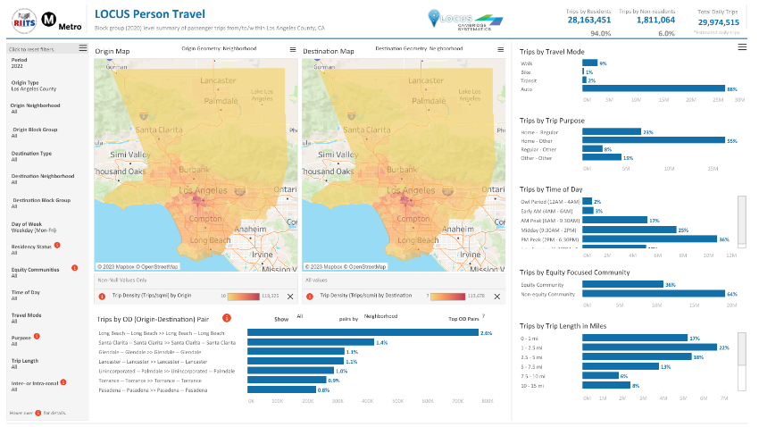
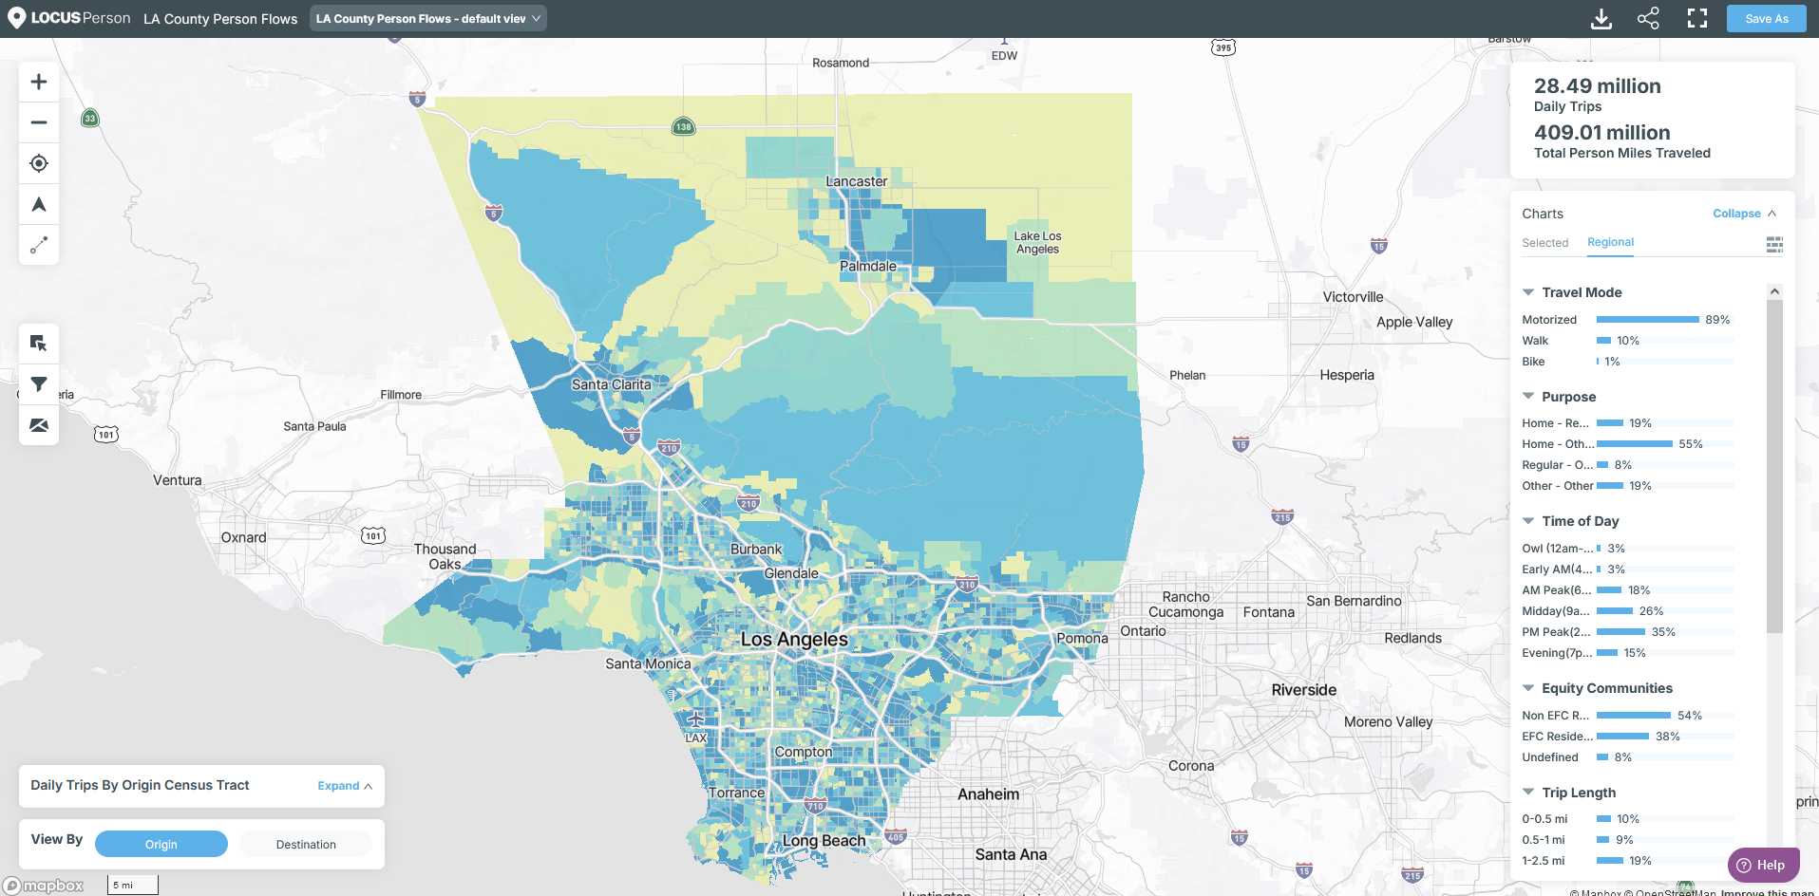
overview
MeasureUp! LOCUS provides multi-year, high resolution origin-destination data that captures multimodal people movement (walk, bike, transit, and auto) in LA County
Ability to overlay community, safety, built-environment, and other local datasets to support diverse project applications
Consistent data to allow trends analysis from 2021 onwards
Platform allows advanced user-defined customizations, analysis, and data downloads

Slide 9
LOCUS Products currently available through measure up!
LOCUS
Person
Expanded & validated origin-destination multimodal person flows and PMT, segmented by travel purpose, resident-status and time-of-day. Uses location-based services data (LBS). Updated quarterly.
LOCUS
Person⁺
Integrates local transit data from Metro and 16+ regional agencies (farecard, APC, ridership data) with LOCUS Person to support transit demand and transit mode share assessments. Updated bi-annually.
Regional transit agencies include – LADOT, Long Beach Transit, Santa Monica BBB, Culver City, Pasadena Transit, Glendale, Gardena, Beach Cities Transit

Slide 10
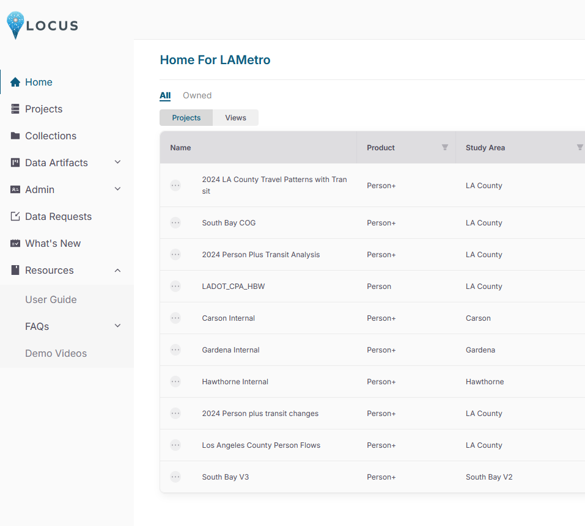
For details on data and methods
Refer to FAQs under “Resources” Tab on the Platform
Join us for Monthly Office Hours
Next on Thursday, April 30, 1pm PT

Slide 11
Data and feature release roadmap

Slide 12
Data release schedule
2021, 2022,
2023, 2024
2025 Q1,
2025 Q2
2025 Q3,
2025 Q4
2026 Q1
Data Years
LOCUS Person
LOCUS Person+
Currently available
Coming soon (May)

Slide 13
New platform features
Vehicle Miles Traveled (Beta)
Activity Durations (Beta)
Measures of auto VMT calculated at the origin-destination pair level
Available in Person+ for 2025 Q1Q2 onwards
Measures of how long people spend at the destination end of the trip (post trip stays)
Available in Person+ for 2025 Q1Q2 onwards
Directional Trip Purpose (Beta)
Small Zone Disaggregation (Coming in May)
Disaggregation of trip purposes (e.g. Home-Regular and Regular-Home)
Available in Person+ for 2025 Q1Q2 onwards
Travel patterns at smaller custom zones (such as TAZ)
Supports up to 5000 zones, with area > 0.05 sq mi

Slide 14
What types of projects can you use locus for?

Slide 15
POLL Question 3
What types of planning and modeling questions do you confront in your projects?

Slide 16
Locus can support wide range of planning and modeling applications
Corridor Studies
Active Transportation Studies
Service Planning & Network Redesign
Grant Applications
Demand Modeling Applications
Mobility Hubs
Travel Demand Management Strategies
Safety Analysis
Travel Trends and Regional Indicators
Airport Catchment Assessments
Origin-Destination Studies
Community Profiles

Slide 17
Locus in action : examples of regional projects
Transit Planning
Corridor/Active Transportation/TDM
LA Metro Bus Network Redesign and Evaluation
Foothill Transit Network Redesign
Crenshaw Green Line & Regional Connector Assessment
Metro Rail Integration Study
Metrolink Burbank Airport Connectivity Study
I 405 Congested Multimodal Corridor Plan (and grant support)
I710 Corridor Study
Metro Active Transportation Plan
OCTA Bikeway Connectivity Plan
Modeling
Freight Planning
Metro Demand Model Calibration
LADOT Model Calibration
SCAG HDT Model Update
Caltrans Zero Emission Truck Infrastructure Study
SCAG HDT/MDT ZETI
Special Events/Venues
Hollywood Bowl Congestion and Parking
SCAG Games Freight TDM

Slide 18
Platform demo

Slide 19
Demo use cases
Market Analysis for New Transit Service
Community Travel Profiles
Game day Travel Patterns
Mobility Hubs

Slide 20
POLL Question 4
What new features/metrics would you like to see in the platform?

Slide 21
Contact information

Slide 22
Contact information
For information on Measure Up!, contact:
Shrota Sharma
(213) 418-3058
sharmas@metro.net
For information on Measure Up!, contact:
Ed Alegre
(213) 418-3287
alegree@metro.net
For information on LOCUS contact:
Pragun Vinayak
pvinayak@locusdata.io
Kathie Xu
kxu@locusdata.io
Visit riits.net to view:
Previous webinar recordings and presentation slides

